Slide 1

BloodBank Management
Group H
-Chintan Bhensdadiya
-Krunal Parmar

Slide 2
Contents
Workflow
UI design
DB
Code Explanation Snippets
CRUD implementation
References

Slide 3
Workflow
Designed UI for all the forms(Login, Home, Users, Donors)
Generated DB based on the UI(tbl_users and tbl_donors)
Implemented database and textboxes for login form.
Implemented CRUD operations.
Bug files
Removed Images(were giving us errors).

Slide 4
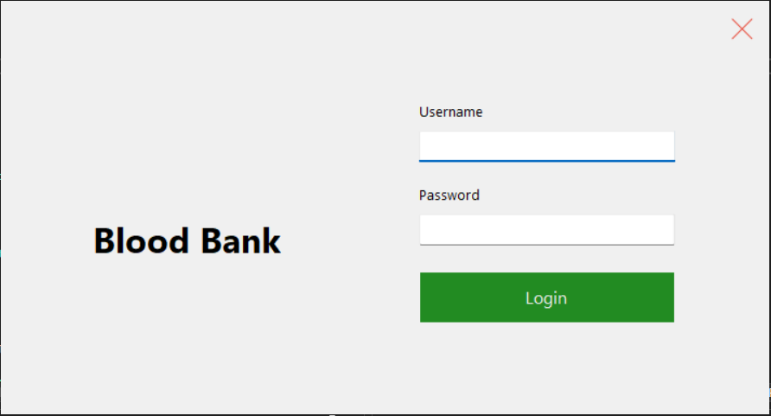
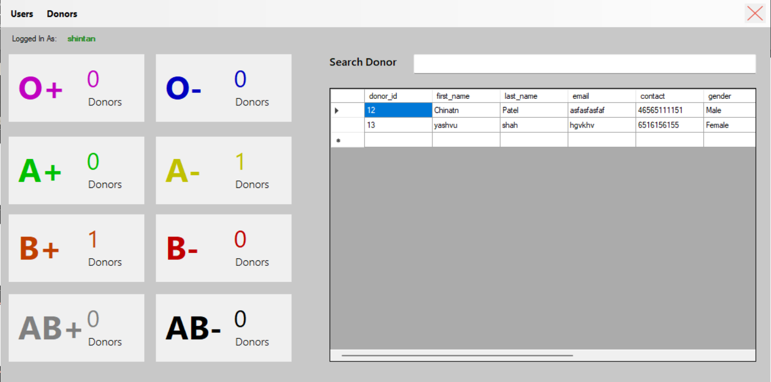
UI
-Login Form
-Home

Slide 5
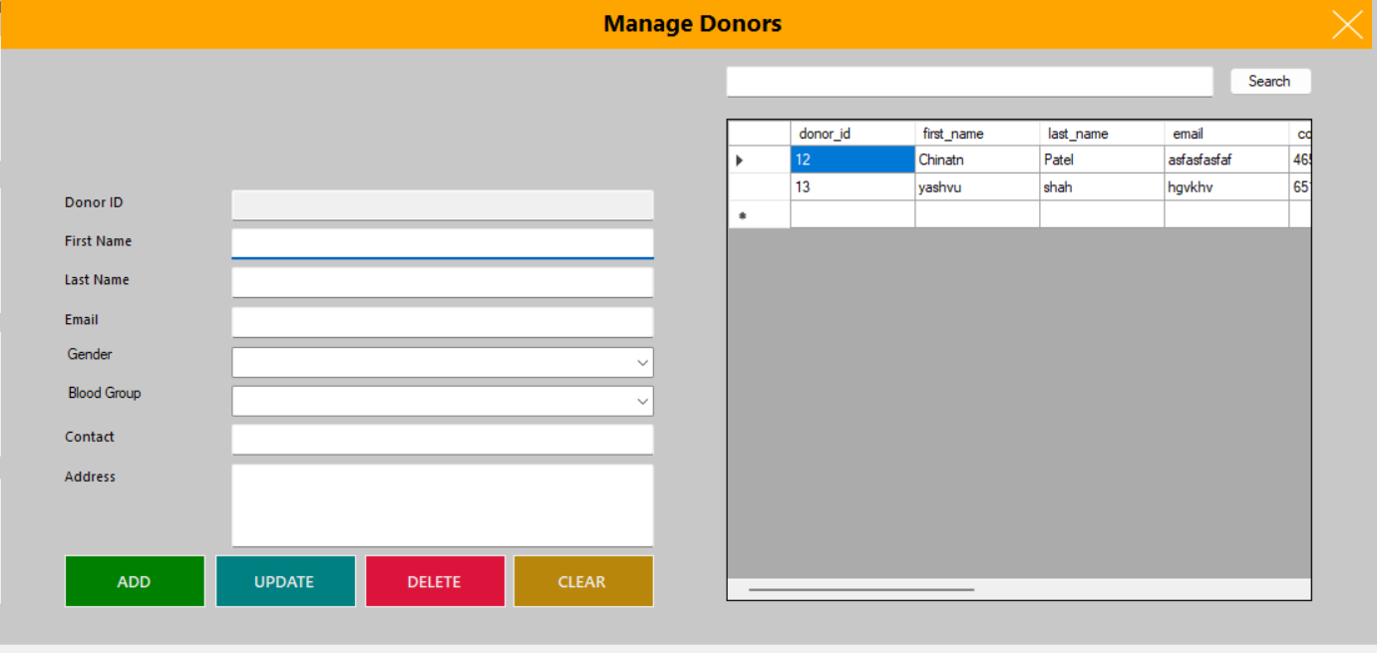
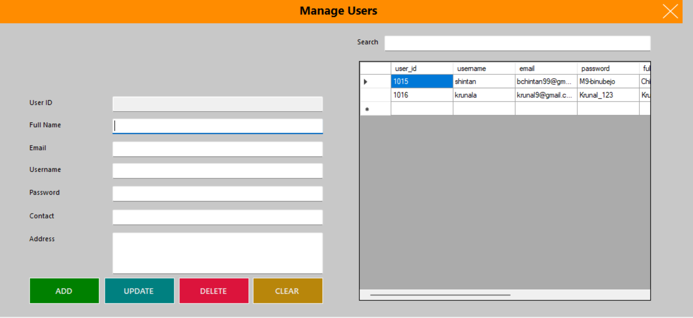
-Donors Page
Users Page

Slide 6
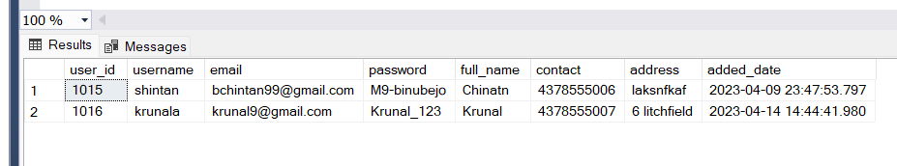
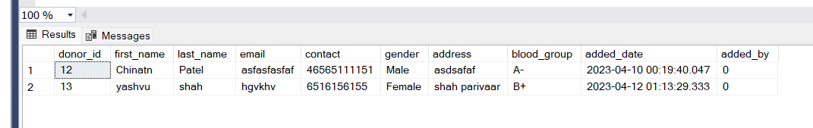
Databases
Users:
Donors

Slide 7
Code Features & CRUD:
- Home Page
Shows Which user is logged in.
Shows Donor counts near respective labels.
Allows user to search the donor.
- User And Donor Pages
Allows CRUD operations

Slide 8
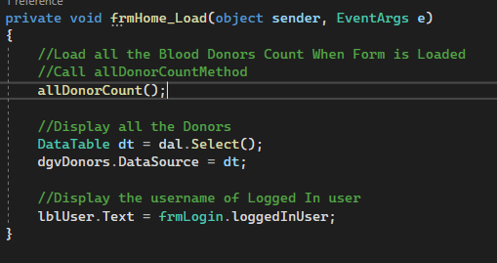
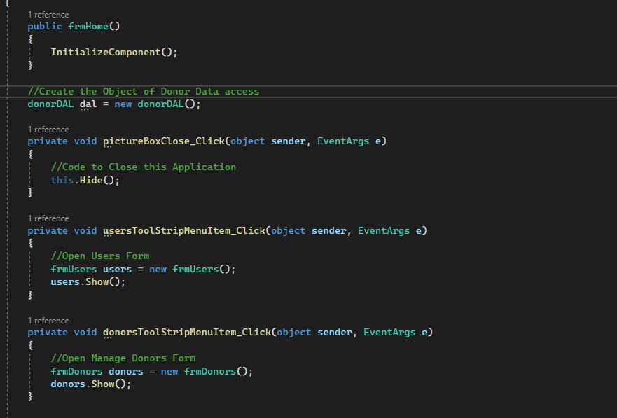
Menu Strip and Form opens on clicking menu strip items.
Shows Who Is Logged In:
Displays all donors in the datatable.
Takes the name from logged in user from login form and displays it.

Slide 9
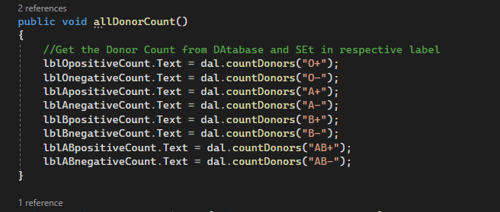
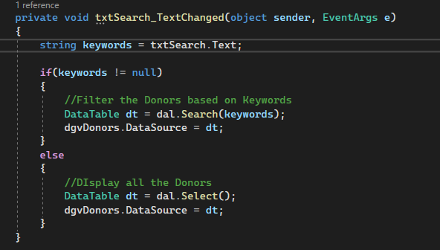
Whenever a new doner is added it shows it in UI with donor counts of that blood group.
Searches from database when key is pressed.

Slide 10
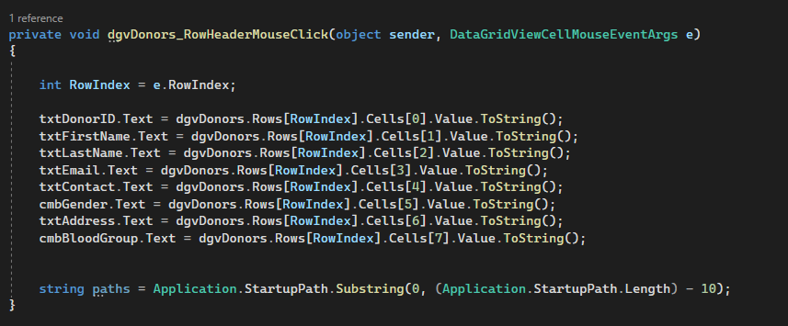
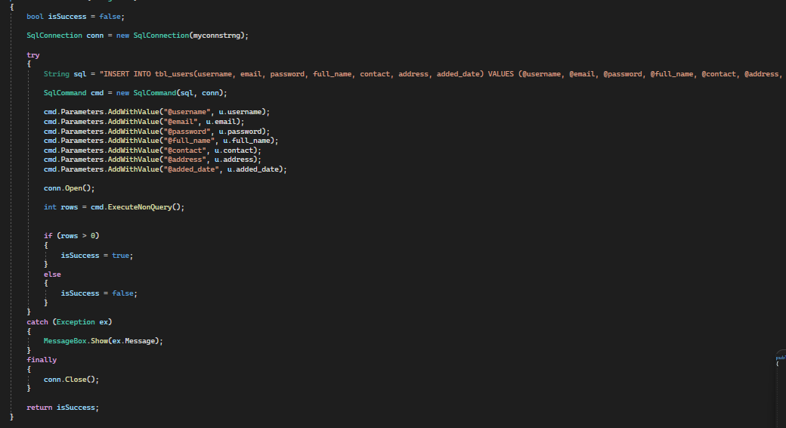
Since we used data grid view and adapter class it lets us select the values using the header function.
-The string path was used to get image but it didn’t work properly and always gave errors.
Insert Method Step-1: We are declaring a Boolean here for confirmation purposes Step2- In try and catch block we run the sql command to insert into db and store everything into rows. If rows is >0 it turns the bool to true and we can ger confirmation messages.
-Update is exactly the same except the sql query.

Slide 11
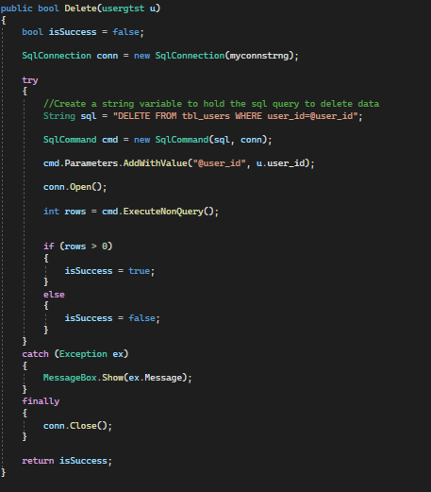
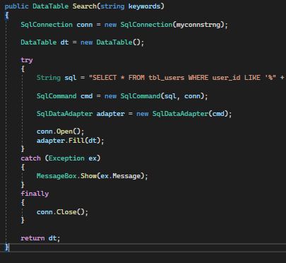
Real time search using txtChanged method and using keyword searches for every key press and different columns such as user_id and name
Same process as insert and del, lets us delete with the help of user ID.

Slide 12
References:
CRUD:-
Working with Adapter:

Slide 13
References:
CRUD: https://youtu.be/NrJiEjzyhYc
Data table: https://youtu.be/_S-LacqE7OM
Sql Adapter method: https://youtu.be/ILBfYojG4-I

Slide 14
Thank You

